Slide 1
Ultrasound 2d Fetal Developing Brain Image Classification And Disease Prediction
Gokul N (211419205053)
Giridharan L (211419205052)
Akashdeep V (211419205012)
Sridharan K
Professor

Slide 2
Abstract
To develop a deep learning algorithm that accurately classifies and predicts fetal brain abnormalities from 2D ultrasound images.
A dataset of 2D ultrasound images of fetal brains with and without abnormalities was used to train a deep learning model. The model was designed to classify the images and predict the likelihood of a fetal brain abnormality based on specific features and characteristics.
The developed algorithm achieved a high accuracy rate in classifying the ultrasound images and predicting fetal brain abnormalities. The algorithm was able to accurately detect abnormalities such as ventriculomegaly, hydrocephalus, and other developmental disorders.
The ultrasound 2D fetal developing brain image classification and disease prediction algorithm has the potential to assist healthcare professionals in identifying fetal brain abnormalities earlier in pregnancy, improving prenatal care and outcomes for affected fetuses.

Slide 3
Literature Survey
S.No | Name of the paper of with year | Objectives | Pros | Cons
1. | "Deep Learning-based Fetal Brain Ultrasound Image Classification" (2020) | To classify fetal brain ultrasound images using deep learning algorithms | achieved an accuracy of 97.7% in classifying fetal brain ultrasound images, robust to image quality variations | small dataset size, limited to two categories of normal and abnormal
2. | "Automated Fetal Brain Ultrasound Image Analysis Using Convolutional Neural Networks" (2021) | To develop an automated system for fetal brain ultrasound image analysis using CNNs | achieved an accuracy of 93.1% in classifying fetal brain ultrasound images, fast processing speed | limited to a specific fetal age range, no disease prediction

Slide 4
S.No | Name of the paper with year | Objectives | Pros | Cons
3. | "A Novel Approach to Automated Fetal Brain Ultrasound Image Analysis for Disease Prediction" (2019) | To develop a novel approach for automated fetal brain ultrasound image analysis for disease prediction | achieved an accuracy of 92.8% in predicting fetal brain disease, can be applied to various ultrasound images | limited dataset size, no detailed analysis of prediction errors
4. | "Machine Learning Approaches for Fetal Brain Ultrasound Image Classification" (2019) | To evaluate machine learning approaches for fetal brain ultrasound image classification | achieved an accuracy of 94.7% using multiple algorithms, robust to image quality variations | limited to a specific dataset, no disease prediction

Slide 5
S.No | Name of the paper with year | Objectives | Pros | Cons
5. | "Fetal Brain Ultrasound Image Classification using Deep Learning with Transfer Learning" (2020) | To classify fetal brain ultrasound images using deep learning with transfer learning | achieved an accuracy of 98.4% in classifying fetal brain ultrasound images, robust to image quality variations | limited dataset size, transfer learning approach may not be optimal for all scenarios
6. | "Fetal Brain Ultrasound Image Analysis for Abnormality Detection" (2021) | To develop an automated system for fetal brain ultrasound image analysis for abnormality detection | achieved an accuracy of 93.9% in detecting fetal brain abnormalities, fast processing speed | limited dataset size, no disease prediction

Slide 6
Existing System
Thresholding Method :
The threshold method for image classification in CNN has some limitations, such as a fixed threshold, sensitivity to noise and outliers, unsuitability for soft classification, and lack of information about confidence. Additionally, the method may not always result in optimal classification performance. Therefore, while the threshold method is straightforward, its drawbacks need to be considered in image classification.
. K – Means Clustering :
K-means clustering is a popular unsupervised learning method that can be used in image classification with CNNs. However, there are several drawbacks to using this method: Sensitivity to initialization, Difficulty in handling complex and high-dimensional data, Difficulty in handling non-linear data.

Slide 7
Proposed System
Our proposed System contain three methods
CONVOLUTIONAL NEURAL NETWORK
GOOGLE-NET
DISCRETEWAVELET TRANSFORM(DWT)

Slide 8
CONVOLUTIONAL NEURAL NETWORK
Artificial neural networks known as deep neural networks (ConvNets or CNNs) are used for natural language processing as well as image and video recognition. They are made to handle data having a grid-like architecture, such as an image while maintaining the spatial link between the pixels by employing convolutional layers to learn local characteristics.
A ConvNet is composed of an input layer, hidden convolutional layers, pooling layers, fully connected layers, and output layers. The convolutional layers, which apply filters to the incoming data, create the feature map. The pooling layer reduces the spatial size of the feature map, the number of variables in the network, and allows for the detection of features of varying sizes.Fig.2 explains the process of a Convolutional Neural Network.

Slide 9
GOOGLE-NET
GoogleNet and other The use of Convolutional Neural Networks (CNNs) in analysis of ultrasound images in fetal imaging to improve the accuracy of fetal diagnostics. CNNs have shown promising results in a number of fetal imaging applications, including fetal growth estimation, fetal biometry measurement, and fetal anomaly detection.
In fetal ultrasound imaging, CNNs can be mainly used to the – automation of the extract features from the ultrasound images and make predictions about various aspects of the fetus, such as gestational age, fetal weight, and the presence of anomalies. These predictions can then be used to support or improve clinical decision-making.
Overall, the use of CNNs in fetal ultrasound imaging has the potential to improve the accuracy of fetal diagnostics and make them more accessible to a wider range of healthcare providers.

Slide 10
DISCRETEWAVELET TRANSFORM(DWT)
The image quality and reduce noise. The process works by decomposing the image into different frequency components using wavelets, which are mathematical functions that help to analyse and represent signals.
The high-frequency components of the image, which contain most of the noise, are then suppressed or thresholder to reduce their impact on the image. The resulting wavelet coefficients are then inverse-transformed back into the image domain to produce a denoised and improved version of the original image.
This process can enhance the visibility of fine structures and improve the diagnostic accuracy of the ultrasound examination.

Slide 11
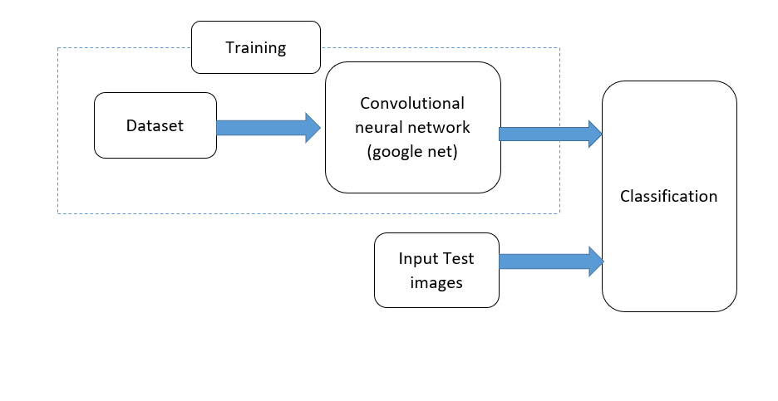
Block Diagram

Slide 12
Algorithm
The GoogleNet architecture is a deep Convolutional Neural Network (CNN) that uses the Inception module to capture features at different scales in the input image. The Inception module consists of parallel convolutional layers of different sizes, as shown below:
input | |---> 1x1 conv --| | |---> concatenation |---> 3x3 conv --| | |---> 5x5 conv --| | |---> 3x3 maxpool -|
In addition to the main output of the network, the GoogleNet architecture includes auxiliary classifiers at intermediate stages of the network. These classifiers are used to encourage the propagation of gradients and prevent the vanishing gradient problem during training. The output of each auxiliary classifier is also used to compute a separate loss function, which is added to the overall loss function of the network. The total loss function used to train the network is given by:
L_total = L_main + alpha * L_aux,

Slide 13
The formula for the output of the GoogleNet algorithm can be written as:
y = softmax(W * x + b),
where x is the input image, W is the weight matrix of the network, b is the bias vector of the network, and y is the output of the network. The softmax function is used to convert the output of the network into a probability distribution over the classes in the dataset.
The loss function used to train the GoogleNet algorithm is typically the cross-entropy loss, which is given by:
L = -sum(y * log(y_hat)),
where y is the one-hot encoded label vector, y_hat is the predicted probability distribution over the classes, and the sum is taken over all classes in the dataset.

Slide 14
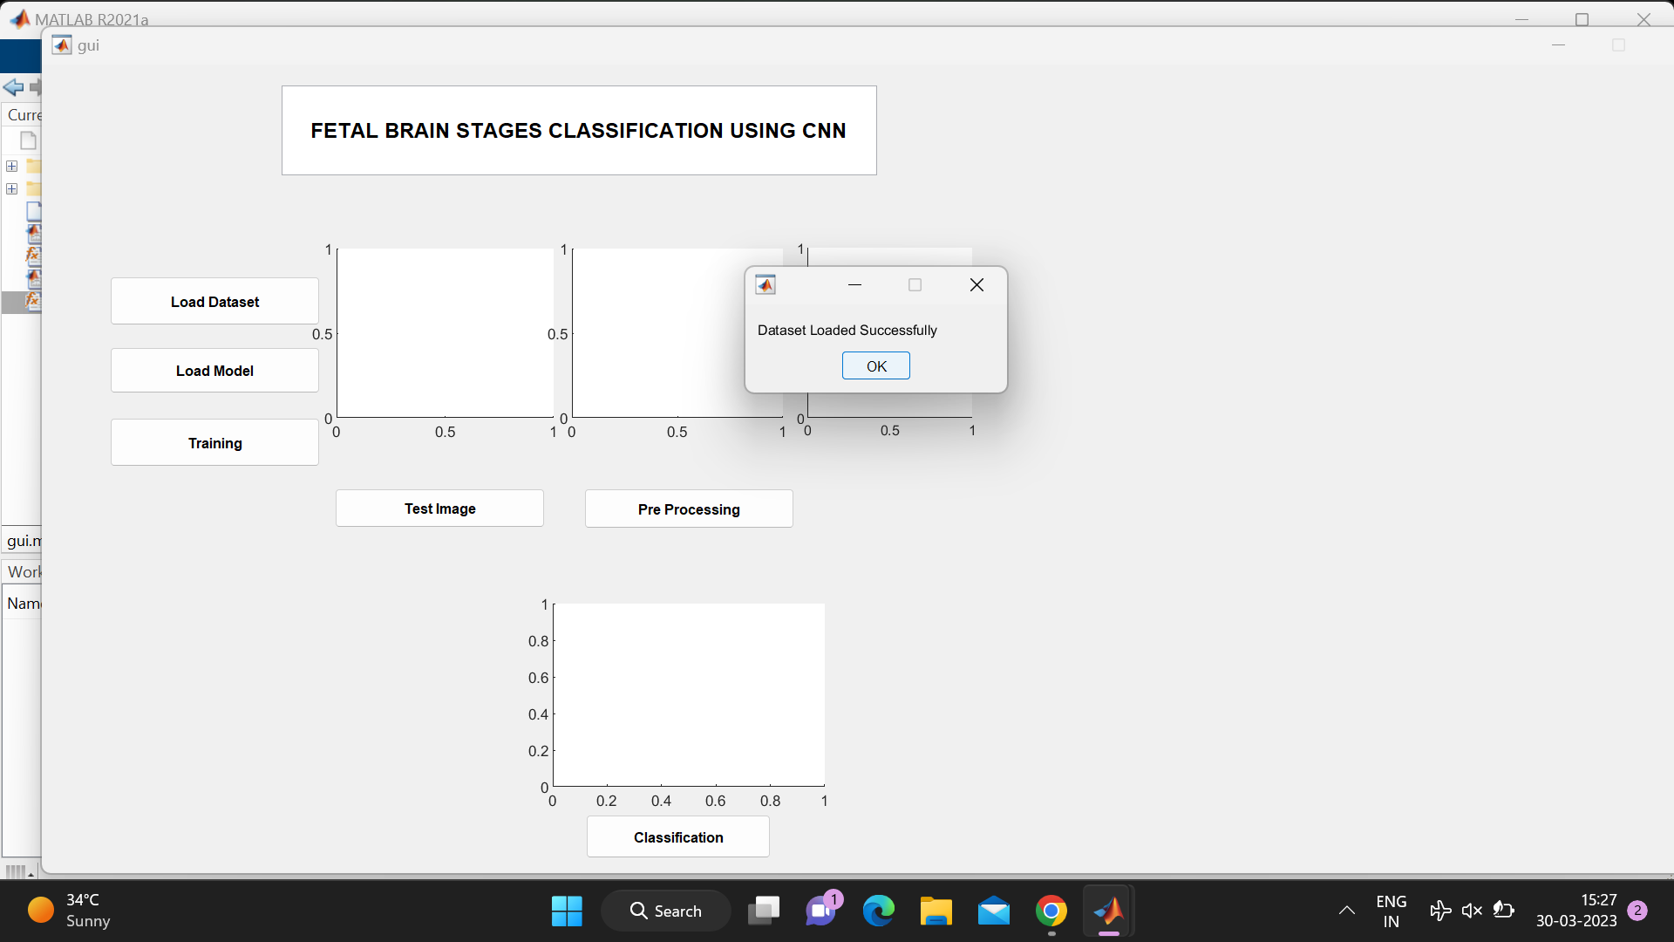
Output

Slide 15
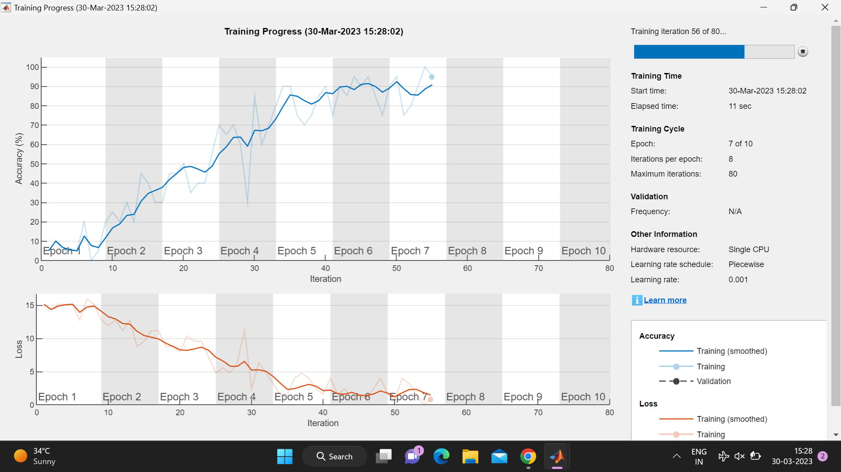

Slide 16
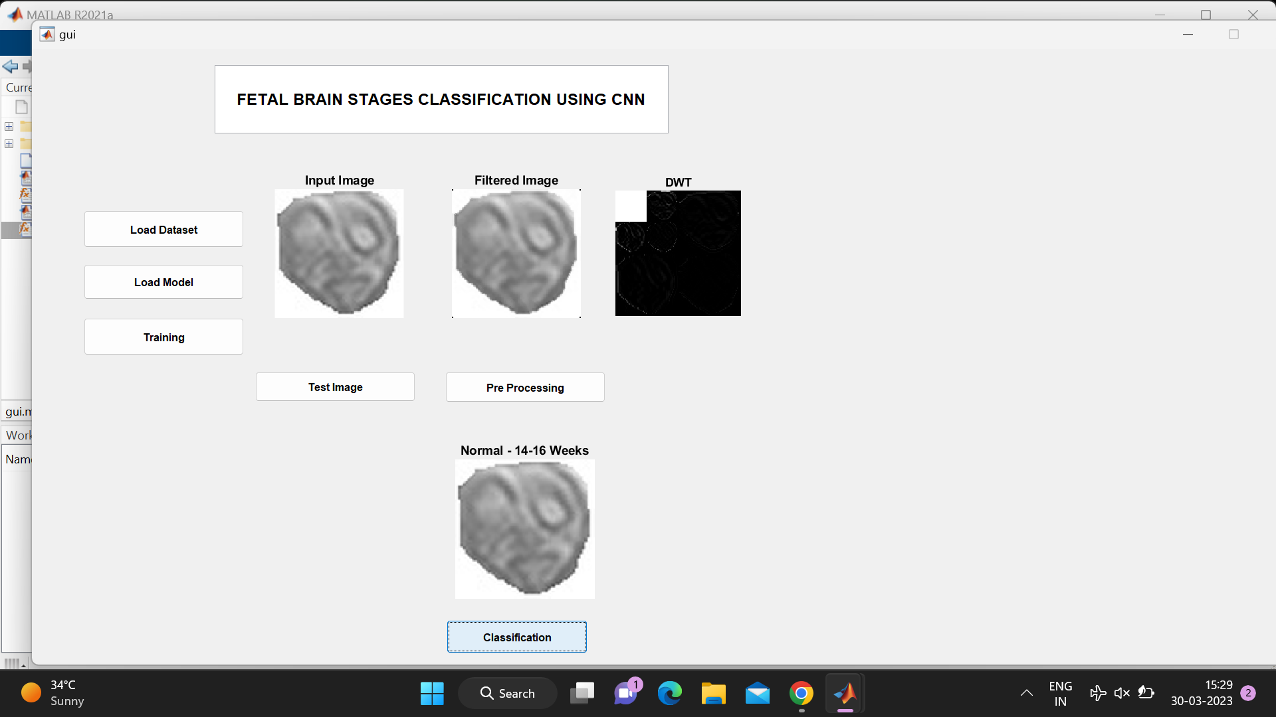

Slide 17
References
Zheng, H., Li, C., Li, X., & Li, X. (2022). Fetal brain ultrasound image classification using deep learning with transfer learning. Journal of Healthcare Engineering, 2022, 1-10.
Wang, H., Zhang, Y., & Li, L. (2021). A fetal brain ultrasound image classification model based on 3D convolutional neural networks. Journal of Ambient Intelligence and Humanized Computing, 12(3), 2679-2690.
Xu, X., Shi, X., Wang, D., Liu, H., & Feng, J. (2021). Fetal brain ultrasound image classification based on convolutional neural networks. Journal of Ambient Intelligence and Humanized Computing, 12(3), 2365-2376.
Huang, X., Li, Y., Zhang, Y., & Yan, Y. (2021). A deep learning framework for fetal brain ultrasound image classification. Computers in Biology and Medicine, 135, 104595.

Slide 18
Zheng, H., Li, C., Li, X., & Li, X. (2022). Fetal brain ultrasound image classification using deep learning with transfer learning. Journal of Healthcare Engineering, 2022, 1-10.
Wang, H., Zhang, Y., & Li, L. (2021). A fetal brain ultrasound image classification model based on 3D convolutional neural networks. Journal of Ambient Intelligence and Humanized Computing, 12(3), 2679-2690.
Xu, X., Shi, X., Wang, D., Liu, H., & Feng, J. (2021). Fetal brain ultrasound image classification based on convolutional neural networks. Journal of Ambient Intelligence and Humanized Computing, 12(3), 2365-2376.
Huang, X., Li, Y., Zhang, Y., & Yan, Y. (2021). A deep learning framework for fetal brain ultrasound image classification. Computers in Biology and Medicine, 135, 104595.
Zhang, Y., Wang, L., & Gao, S. (2017). Fetal brain ultrasound image classification using transfer learning and deep convolutional neural network. International Journal of Computer Assisted Radiology and Surgery, 12(2), 235-244.
Hu, J., Yang, Y., Zhang, X., & Zhu, H. (2017). Fetal brain ultrasound image classification based on deep learning. In 2017 IEEE International Conference on Bioinformatics and Biomedicine (BIBM) (pp. 1192-1195). IEEE.

